Slide 1











Practical Guide to Building 3D Web Apps
Please leave artwork “+” clustered.
Do not use them alone, as bullet points, or as a “plus” concept. Thank you.
Kristian Ekenes & Russell Roberts
2020 ESRI FEDERAL GIS CONFERENCE | WASHINGTON, D.C.

Slide 2


Session Overview
Introduction to 3D
Web scenes
Build custom web app with web scene
Notes:
Today’s seminar covers these topics: <topic 1>, <topic 2>, and <topic 3>.
The format will include a discussion of the topics and software demonstrations.

Slide 3




Introduction to 3D
Concepts and getting started

Slide 4
What is 3D in the platform?
Scene layers and feature layers
Powered by services; accessible across clients
Combine 2D and 3D in Esri WebGIS architecture
Create higher value visualizations, analyses, and information products using data and geoprocessing with 2D and 3D
Web scenes as building blocks for 3D apps
Desktop
Web
Device
Server
Online Content and Services
Notes:
So… ArcGIS 3D is not just about a collection of 3D-capble desktop applications, or web front ends. We’re not just a data server. The ArcGIS system is designed to help organizations who need to be able to: create, manage, share, AND consume… 2D and 3D map information
…enabling people to ultimately make “more informed decisions”, thru the better-understanding that 3D enables.
…The same layers I author in the desktop ArcGIS Pro, can be shared and combined into 3D web scenes that I use as “the basis” for my 3D web applications. …The “author once” …. consume-everywhere is a another compelling aspect of the platform.

Slide 5
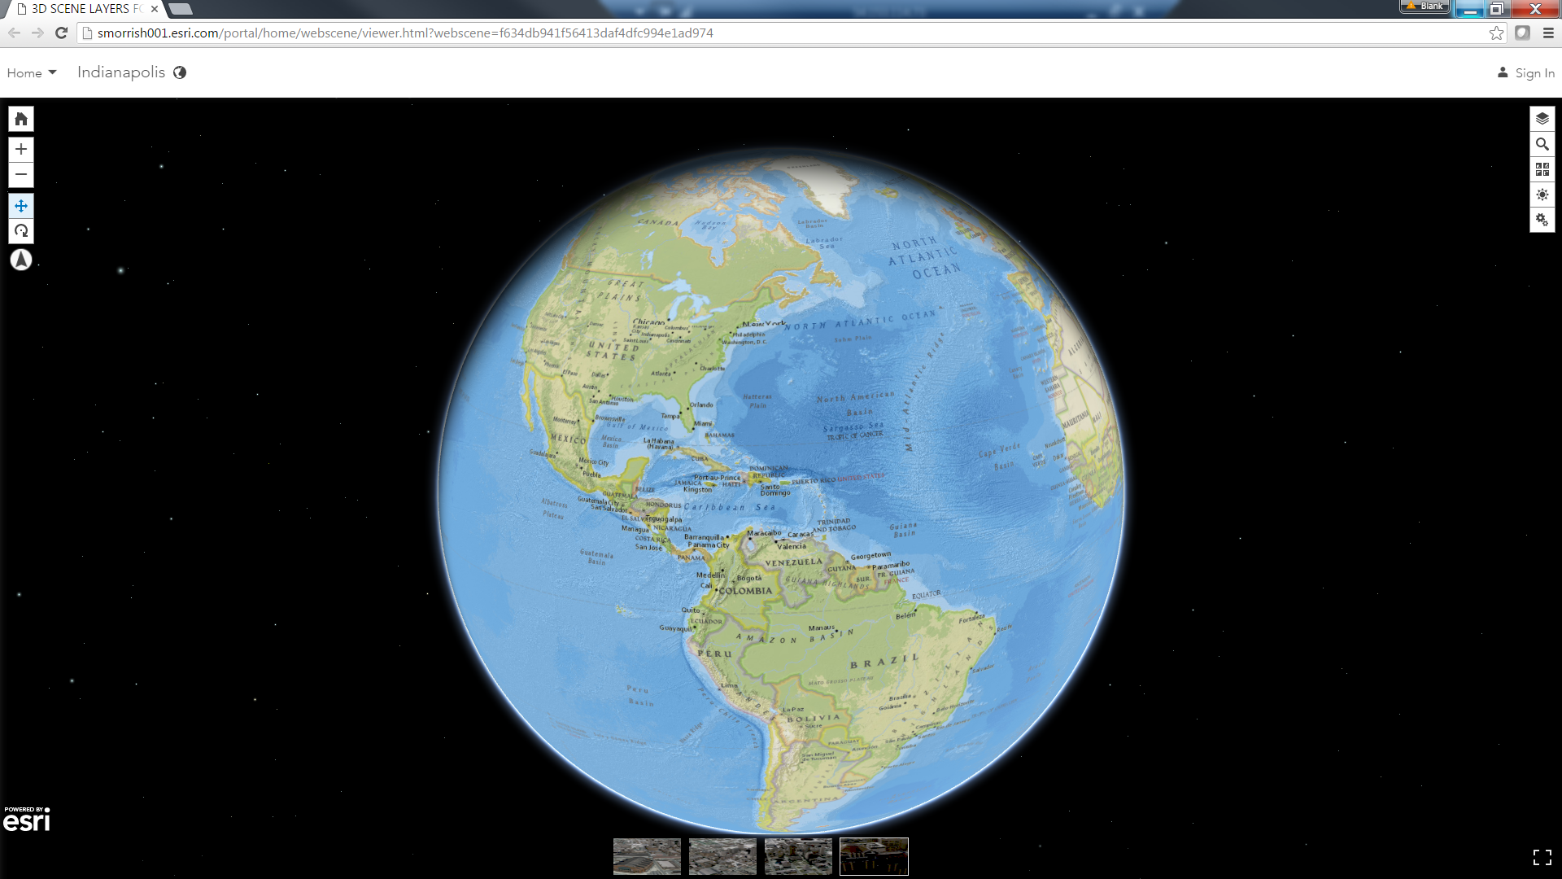
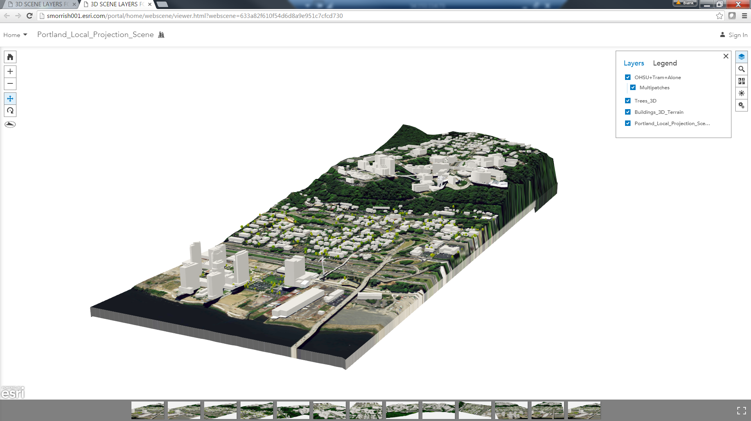
Global vs. local scenes
Global
Web Mercator or WGS84
Sphere/curved surface
Local
Any PCS (including Web Mercator)
Flat surface/no curvature
ClippingExtent
Underground navigation

Slide 6
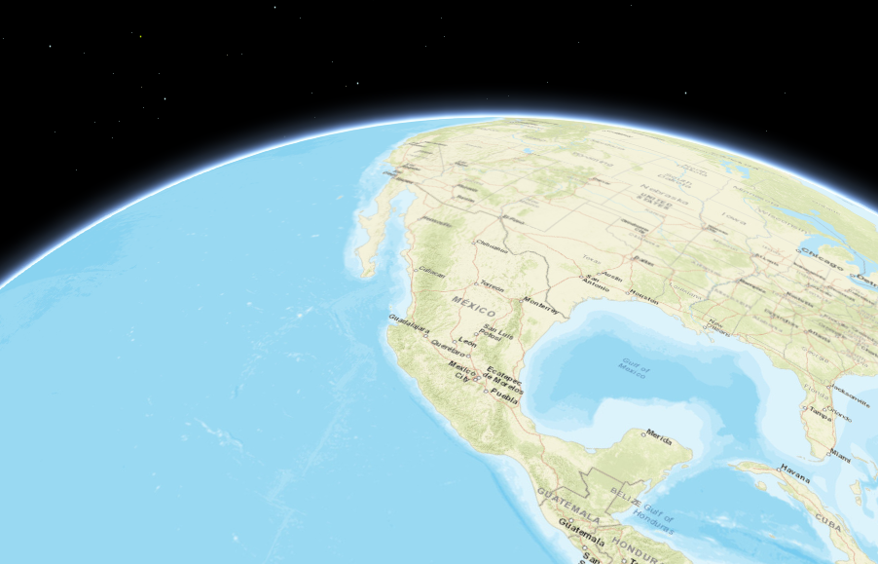
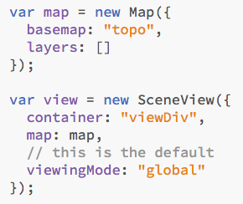
Global scene

Slide 7
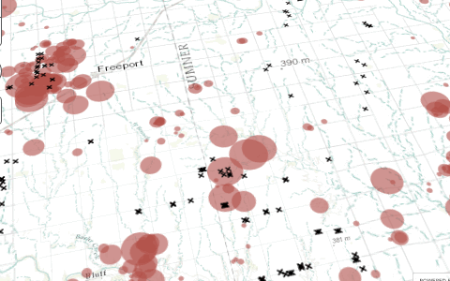
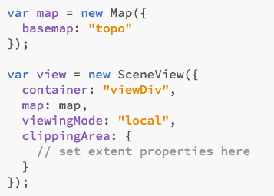
Local scene

Slide 8
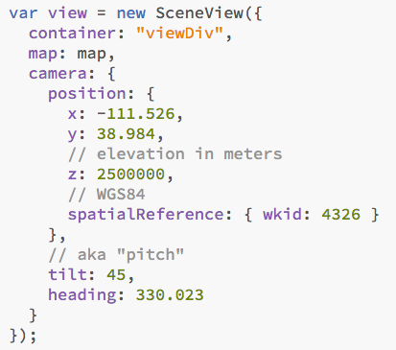
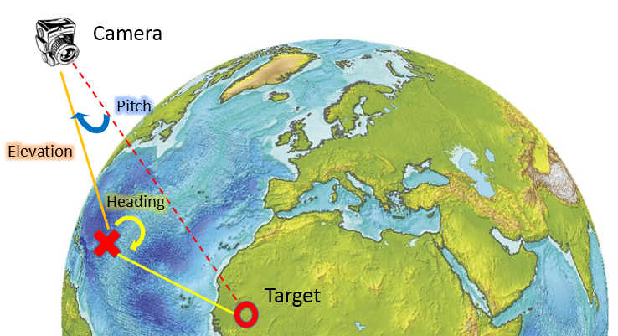
Camera

Slide 9
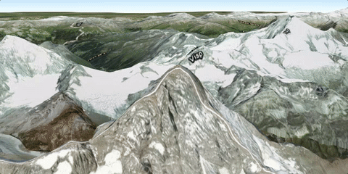
Elevation layers
Provide vertical geographic context to your map
Can be published to Portal for ArcGIS or ArcGIS Online

Slide 10
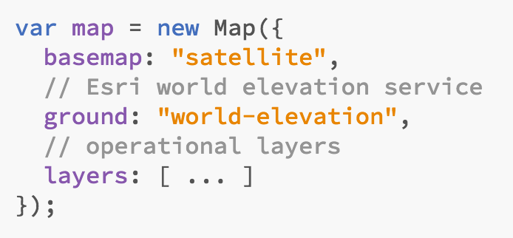
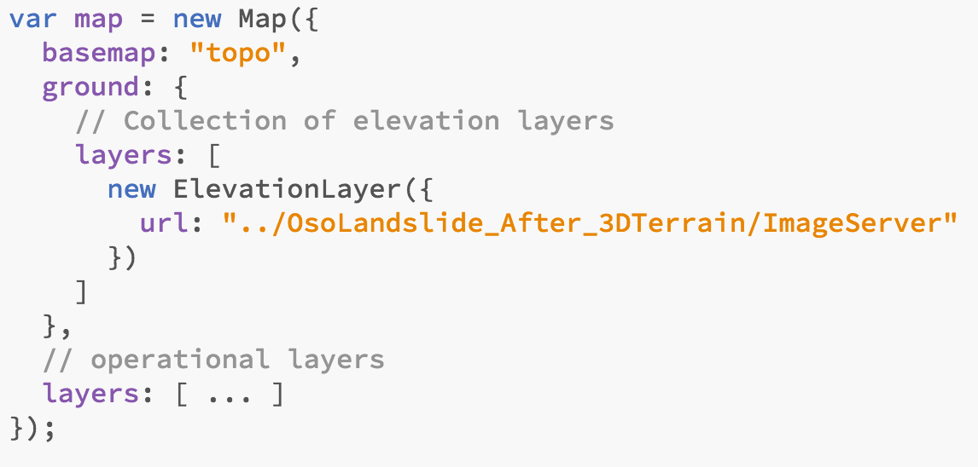
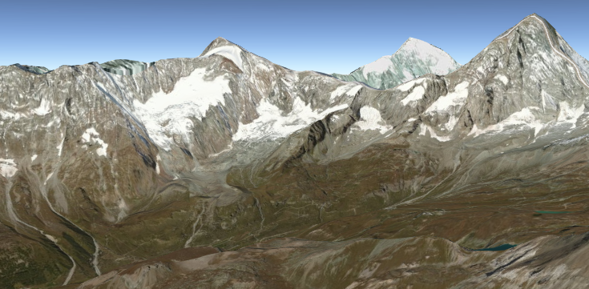
Elevation layers

Slide 11
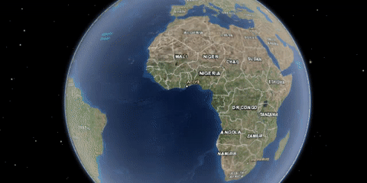
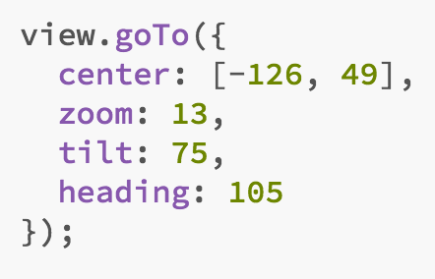


Navigation
Manual with mouse and keyboard gestures
Programmatic navigation with goTo()

Slide 12
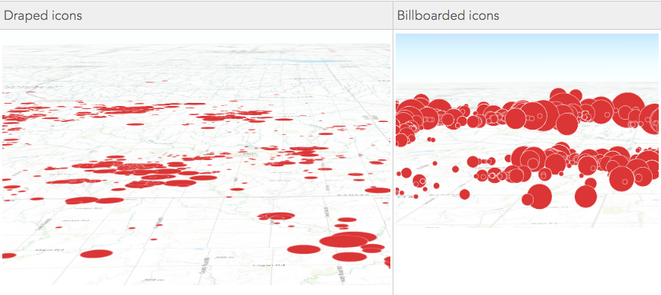
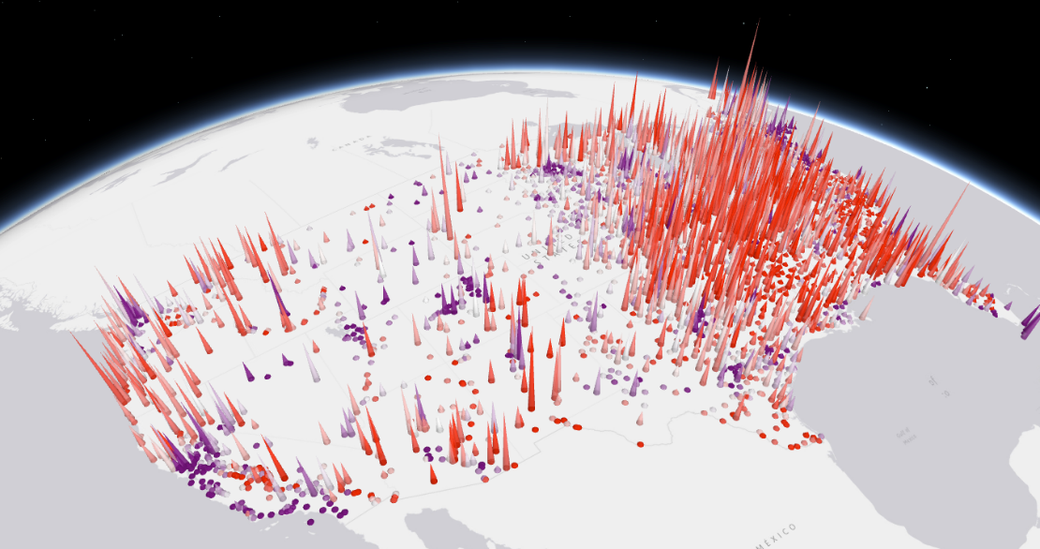
Visualization
2D symbols
Billboarding vs. draping icons
Size in pixels/points
3D symbols
Color has slight changes with environment settings
Size expressed in meters

Slide 13
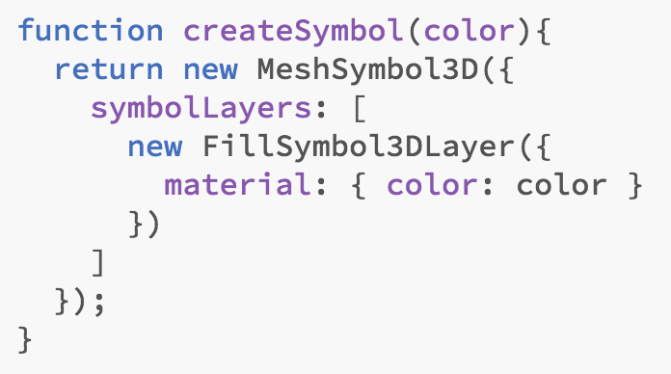
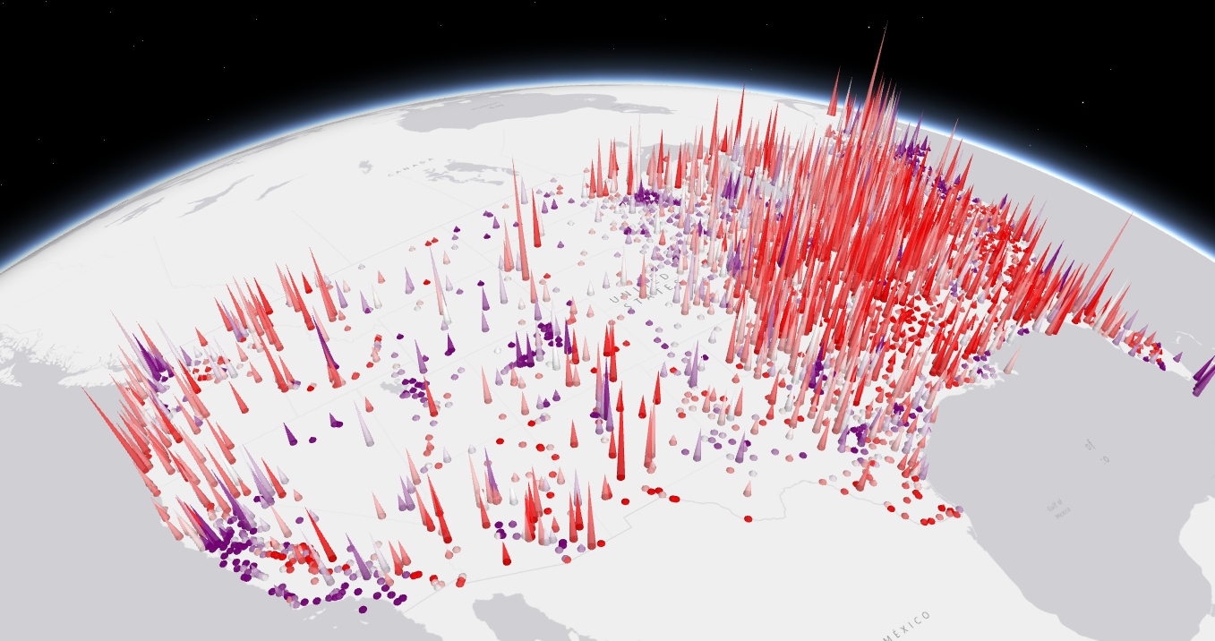
Visualization
Symbol layers within 3D symbols drive the visualization

Slide 14
Web Scenes
Russell Roberts

Slide 15
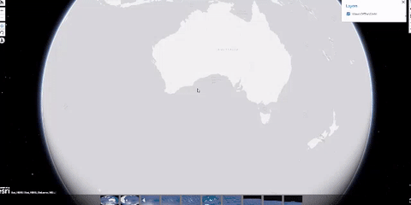
Web scenes
Author in ArcGIS Online (can also be done in ArcGIS Pro)
Publish layers in ArcGIS Online
Author the scene with slides
Save – get item ID

Slide 16
Intro to web scenes
Allow you to visualize and analyze geographic information in an intuitive and interactive 3D environment
Can add and customize 2D and 3D layers
Feature layer, map image layer, scene layer
Control environment settings
Shadows
Time of day
Can be global or local
Notes:
Today’s seminar covers these topics: <topic 1>, <topic 2>, and <topic 3>.
The format will include a discussion of the topics and software demonstrations.

Slide 17
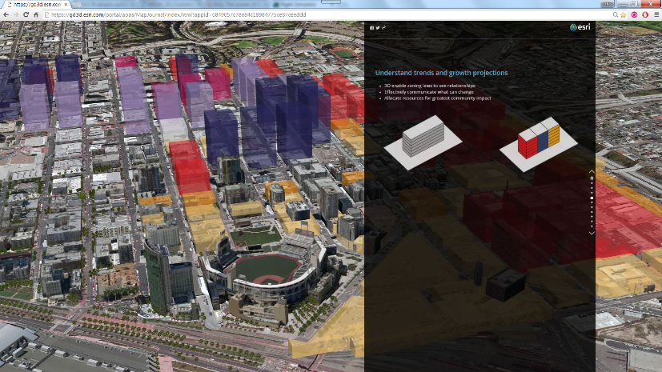
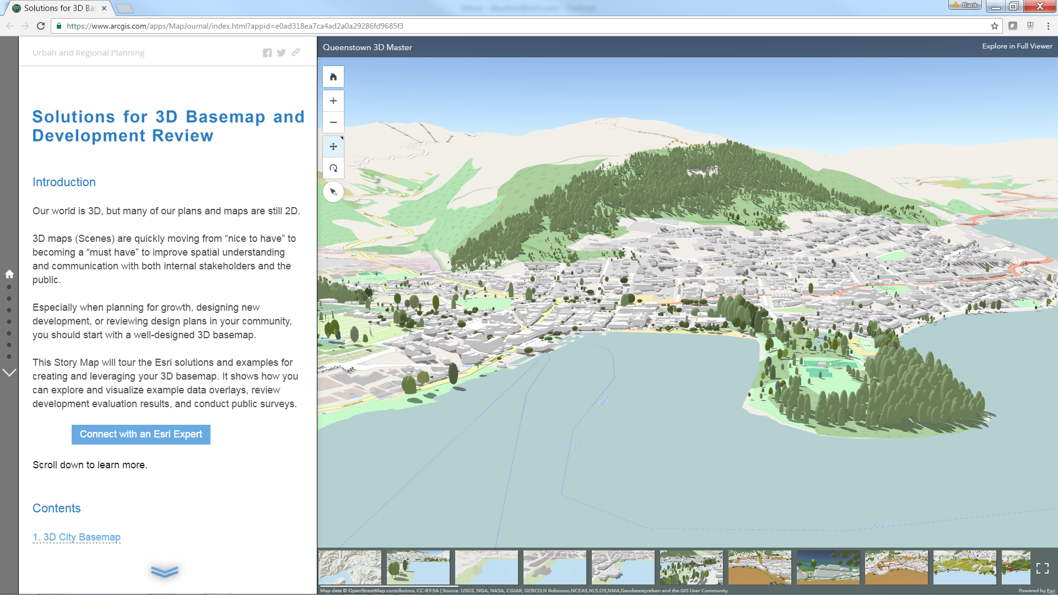
Scene layers
Cached web layers that are optimized for displaying a large amount of 2D and 3D features and can be viewed in the scene viewer
Three different types of scene layers:
Point
3DObject
IntegratedMesh
Notes:
Today’s seminar covers these topics: <topic 1>, <topic 2>, and <topic 3>.
The format will include a discussion of the topics and software demonstrations.

Slide 18
How to create a scene layer in ArcGIS Online
You can create scene layers two ways in ArcGIS Online
Upload a scene layer package created from ArcGIS Pro, Drone2Map or CityEngine
Publish a scene layer from a feature layer
Notes:
Demo recap of creating a scene layer
1. This will take the styling and attributes in your multipatch dataset and packaged into the scene layer package
2. Uploading the package can be done through Add Item under My Content or you can use ArcGIS Pro – Share Package GP tool
3. This will create a hosted scene layer with the same styling and attributes as the multipatch dataset.
https://geonet.esri.com/people/GTaylor-esristaff/blog/2016/01/13/create-floors-from-3d-building-models

Slide 19
How to create a web scene in ArcGIS Online
Click the Scene text inside your organization to launch the scene viewer
Add 2D and 3D layers to your web scene
Configure your web scene
Notes:
Demo recap
1. Depending on the default basemap projection the scene will launch in global or local mode.
2. You can add layers from your Organization, ArcGIS Online or your ArcGIS Server
3. Change the basemap, add slides, change extents, setup environment settings…

Slide 20
Build an app with a web scene
Kristian Ekenes

Slide 21
Load scene into custom app
Portal API – loading a scene
Slides
Custom visualizations
Pop-ups

Slide 22
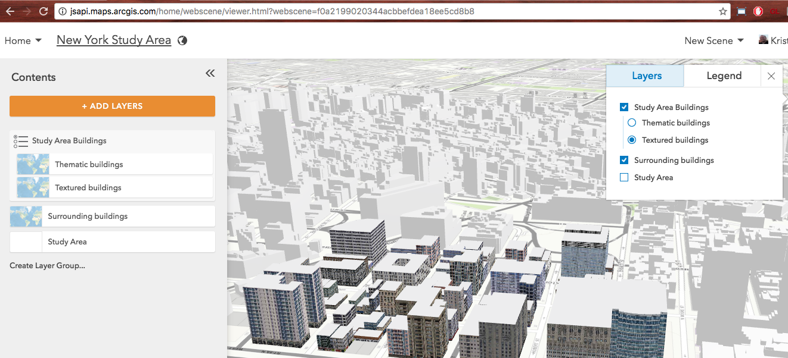
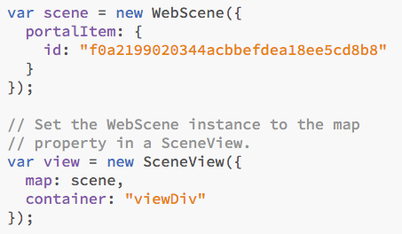
Load the scene in a custom app

Slide 23
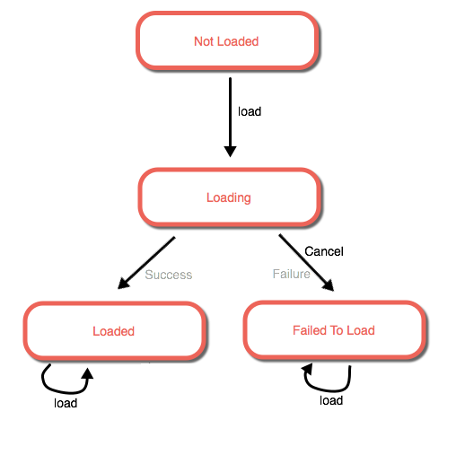
Loadable pattern
Loaded means that the resources are available and ready for drawing
Does not mean features have completely drawn in the view

Slide 24
When are the resources loaded?
The view is a promise, which resolves when the view is ready and when the scene’s resources have finished loading
view.when()

Slide 25
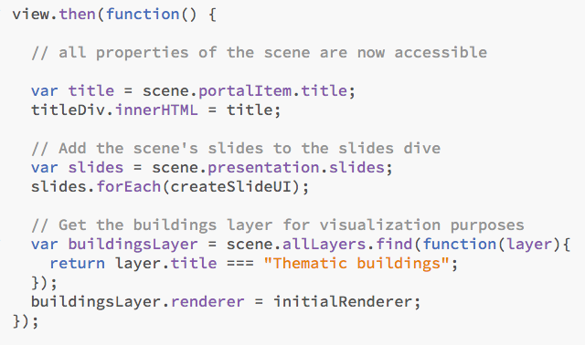
Access scene properties

Slide 26
Working with slides
Slides are a property of the presentation available in the scene
Available after the view is loaded

Slide 27
Working with slides
Slides save the following properties of a view:
Viewpoint (alternative to camera)
Visible layers
Basemap
Environment settings
Other metadata: title, description, thumbnail

Slide 28
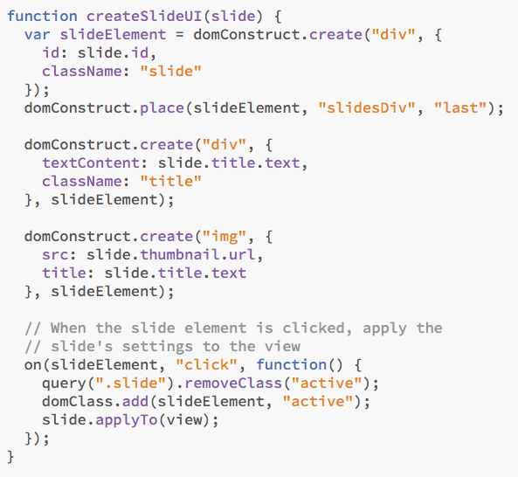
Working with slides
slide.applyTo(view)

Slide 29
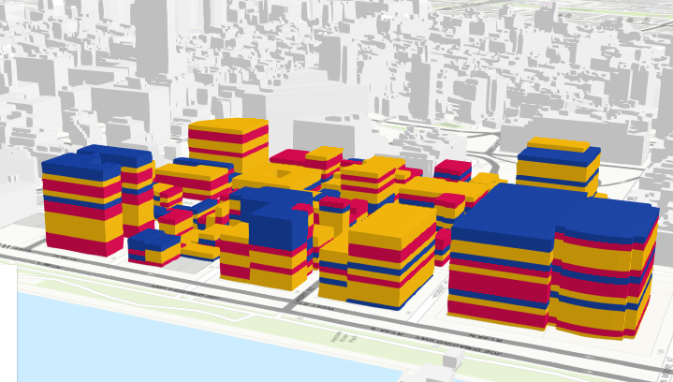
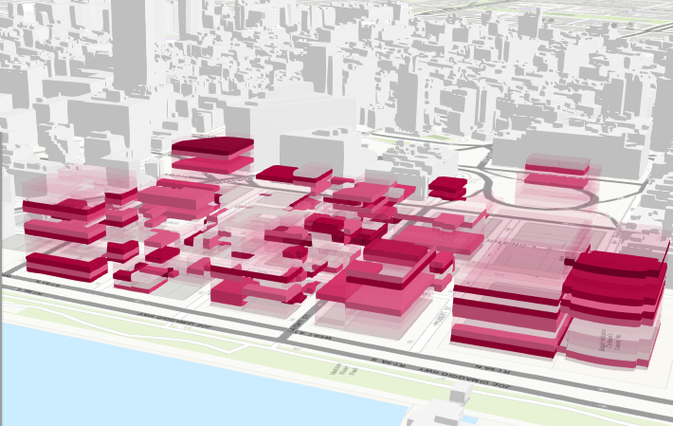
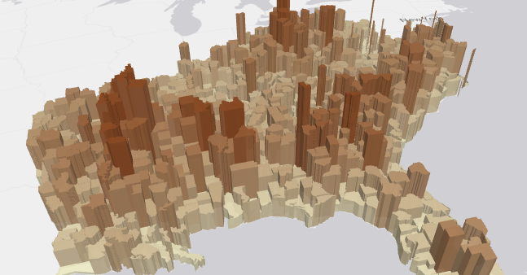
Create custom visualizations
Unique values
Visual variables for numeric data (color, size, opacity)

Slide 30
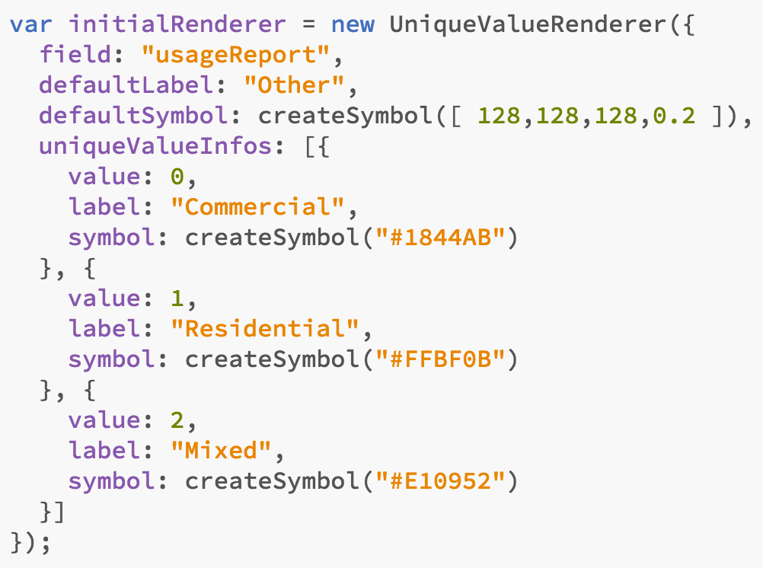
Renderers

Slide 31
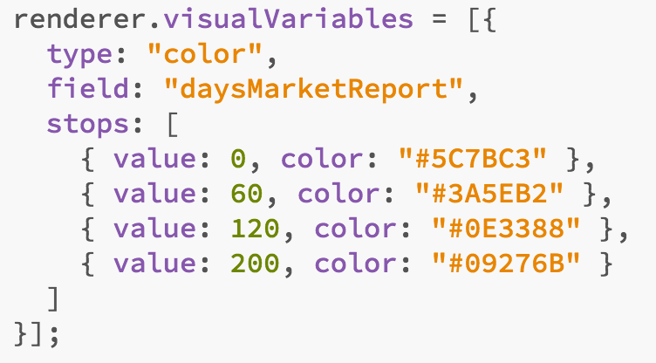
Visual variables

Slide 32
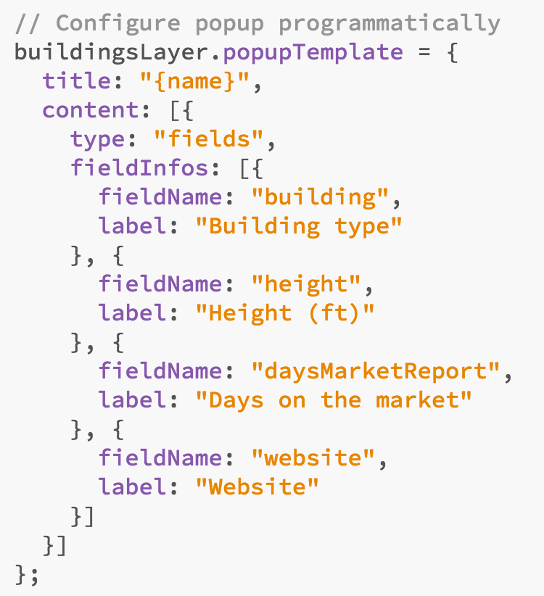
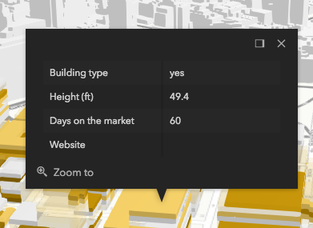
Configure the popup

Slide 33


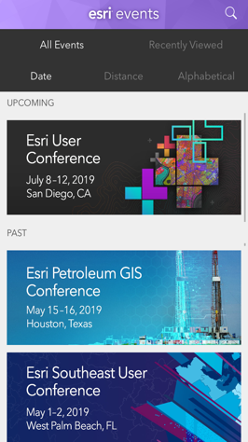
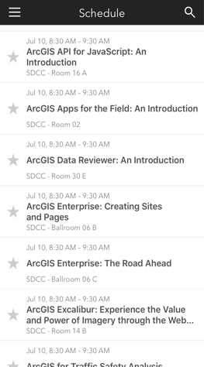
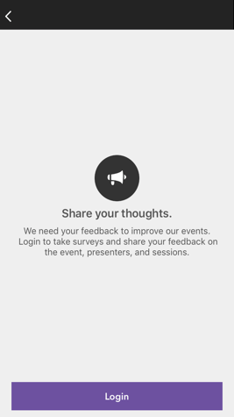
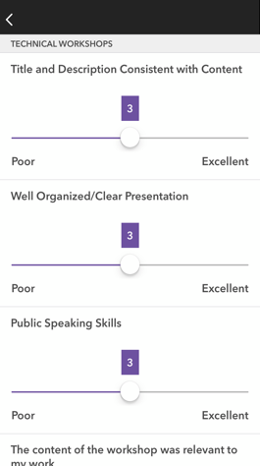




Please Share Your Feedback in the App
Download the Esri Events app and find your event
Select the session you attended
Scroll down to “Survey”
Log in to access the survey
Complete the survey and select “Submit”
Notes:
Guidance:
This is the survey slide. You can use the example as is or you can screenshot your session.

Slide 34

Please leave artwork “+” clustered.
Do not use them alone, as bullet points, or as a “plus” concept. Thank you.

